Slide 1
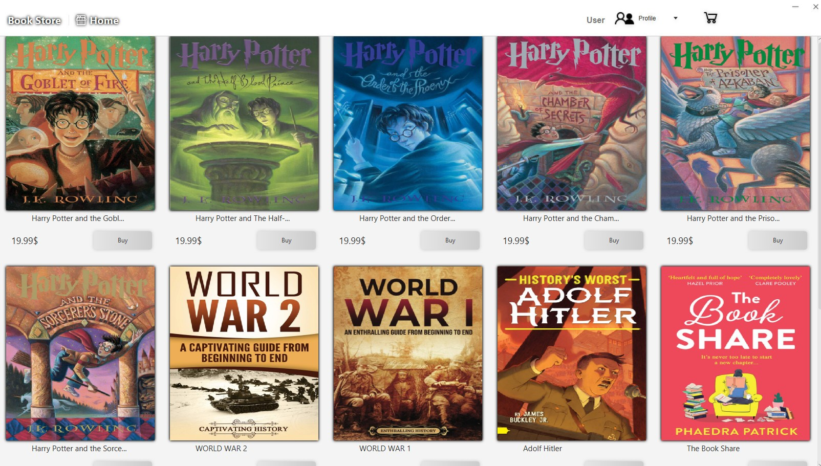
BookStore

Slide 2
Our Team
Group 3 – T5.2308.M0:
Pham Huu Nam Anh Student1501062
Vuong Huu Thang Student1501300
Tran Vinh Quang- Student1501274
Nguyen Thanh Nghia Student1477169

Slide 3
Pham Huu Nam Anh
Register-Login System

Slide 4
Login and Register
Admin and User
Permission: Login and Register, book user
Database:
User

Slide 5
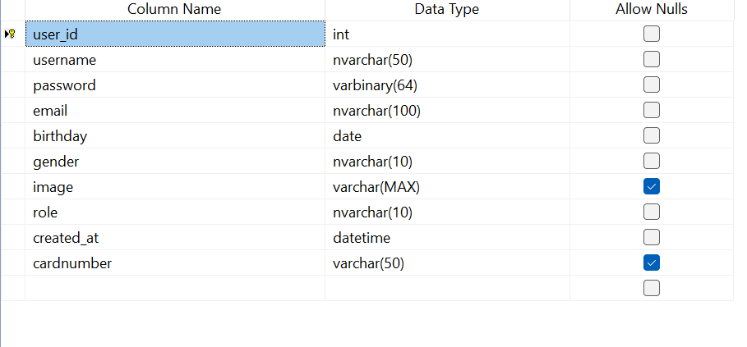
Database

Slide 6

Login Form

Slide 7
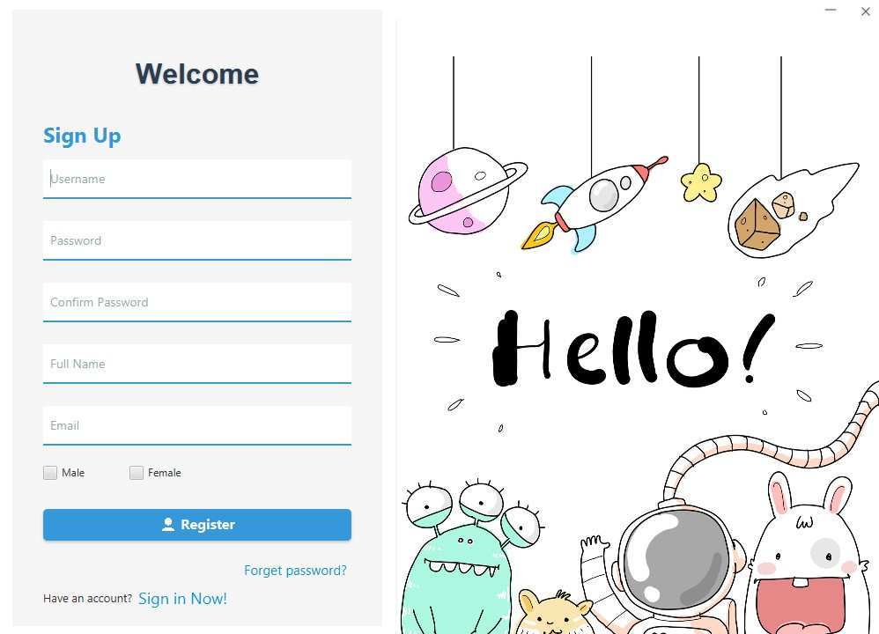
Register

Slide 8
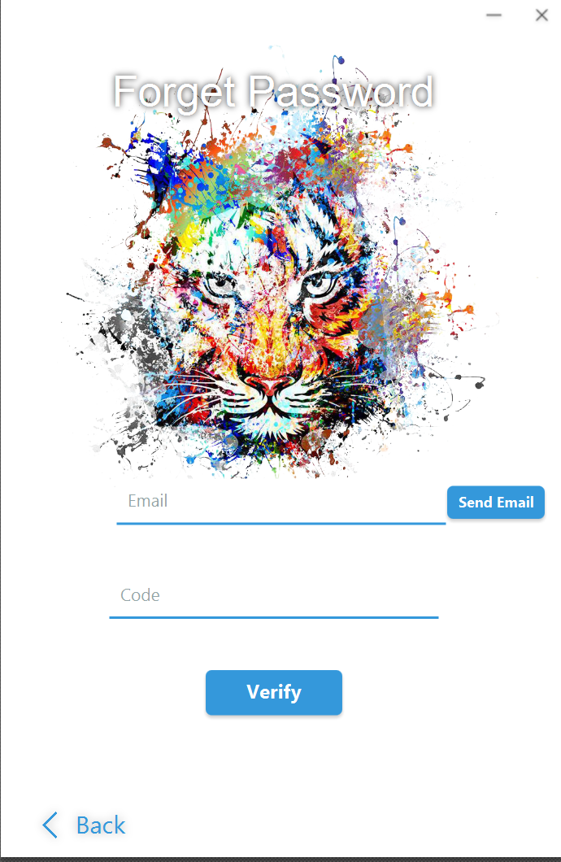
Forget Password

Slide 9
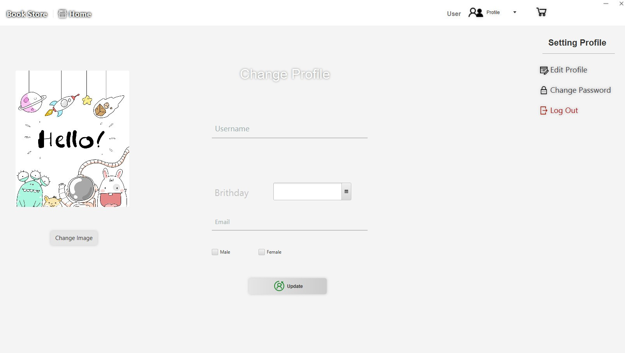
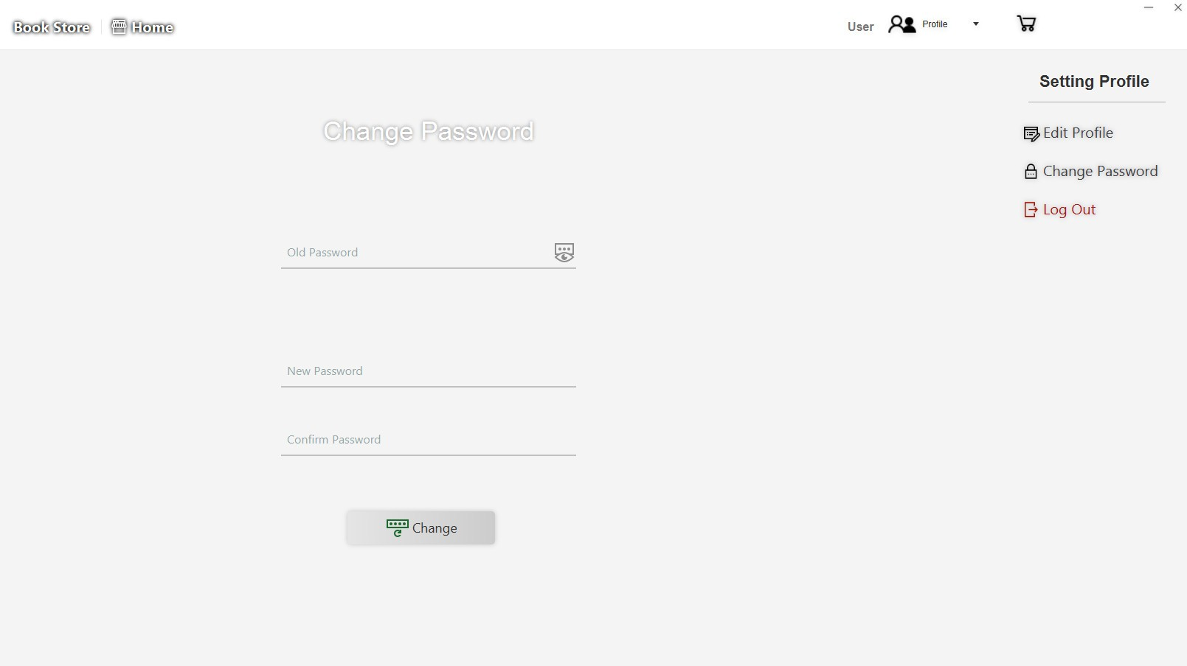
User Profile

Slide 10
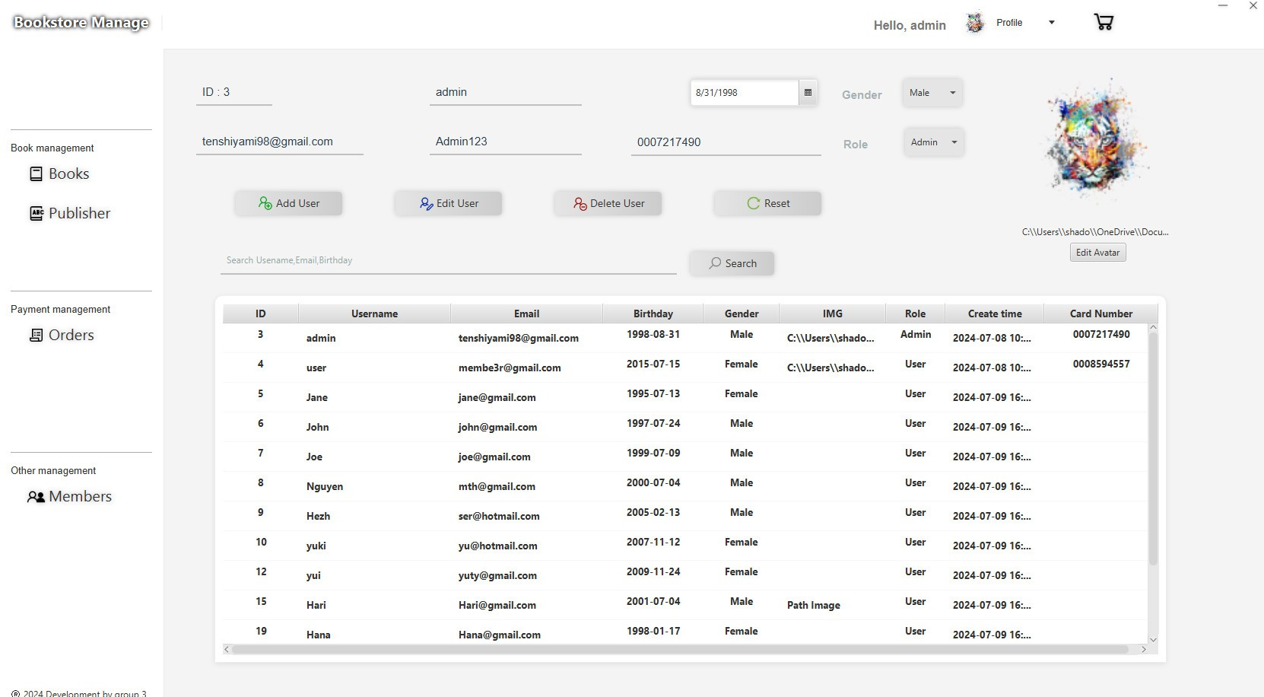
Edit User By Admin

Slide 11
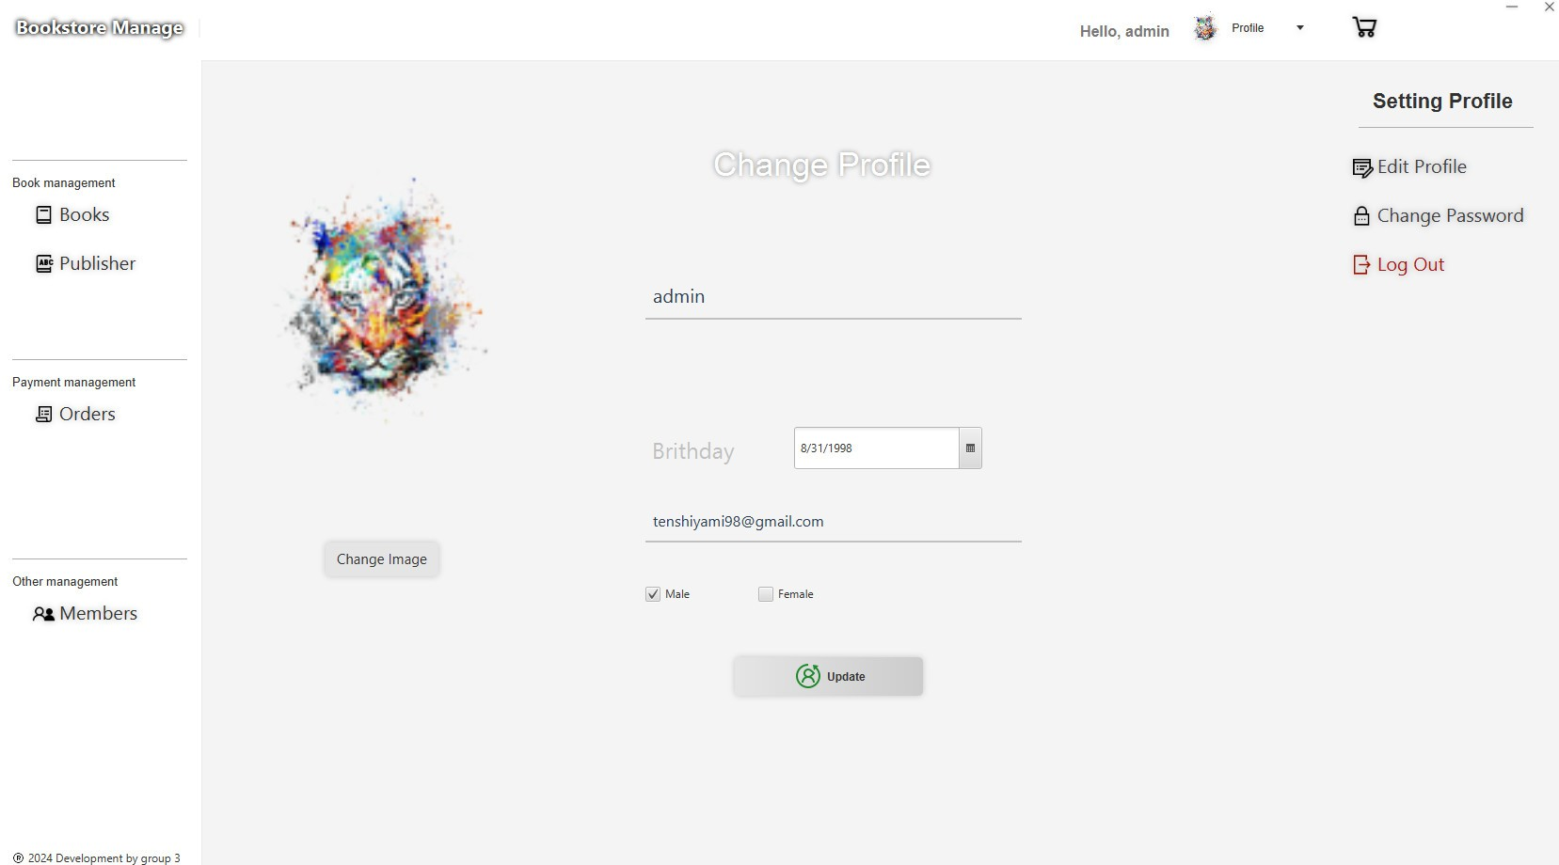
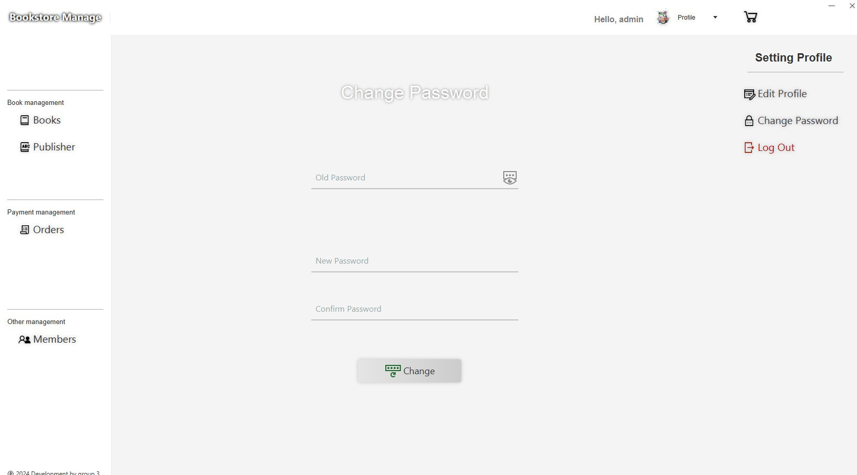
Profile Admin

Slide 12
Book Reviews
(User)
List Book Available

Slide 13
Vuong Huu Thang
Books-Book Review

Slide 14
Books and Book Review
Admin ,User
Database:
Book

Slide 15
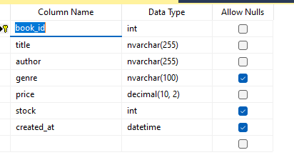
Database

Slide 16
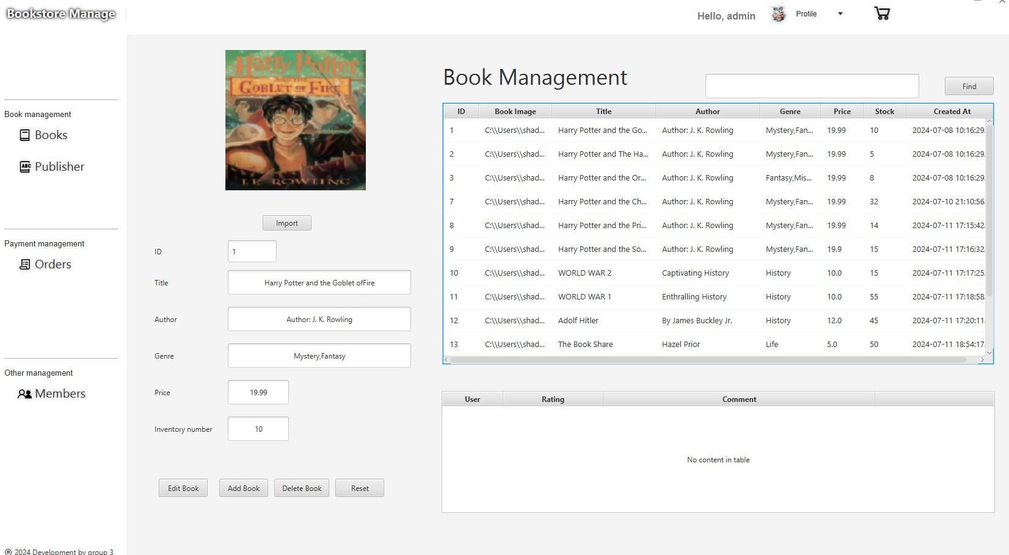
Book Management
(admin)

Slide 17
Nguyen Thanh Nghia
Payment-Shopping cart

Slide 18
Payment and Shopping cart-Shopping cart items
User
Permission
Database:
Payment, Shopping cart, Shopping cart items

Slide 19
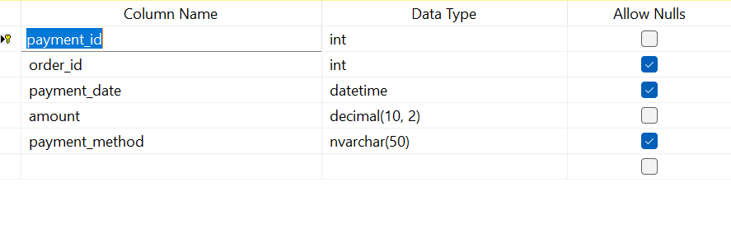
Database Payment

Slide 20
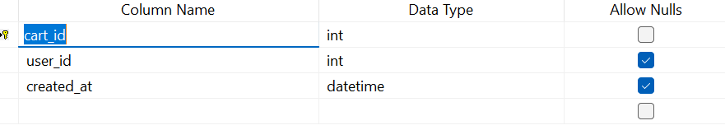
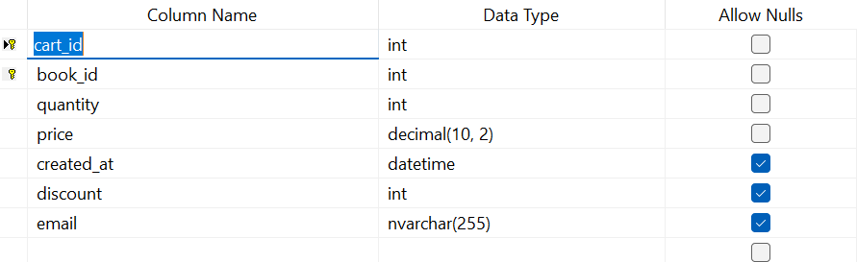
Database Shopping cart-Shopping cartItems

Slide 21
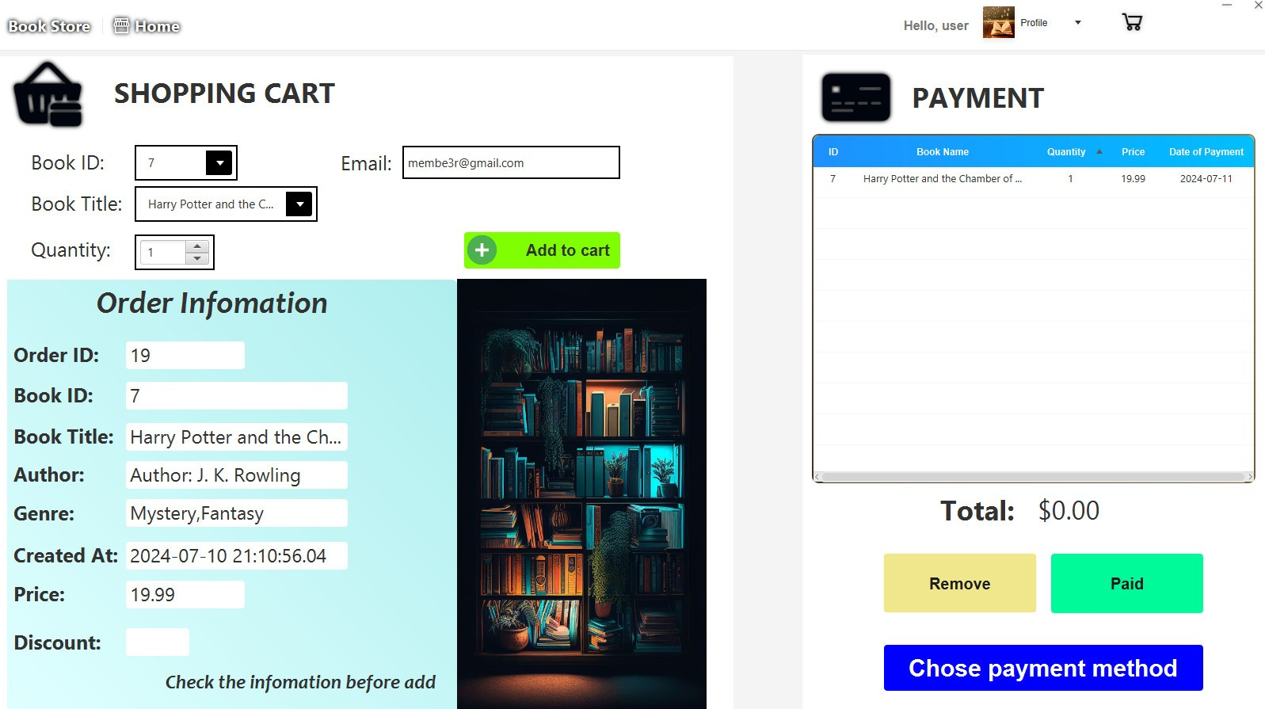
BOOKS SHOPPING

Slide 22
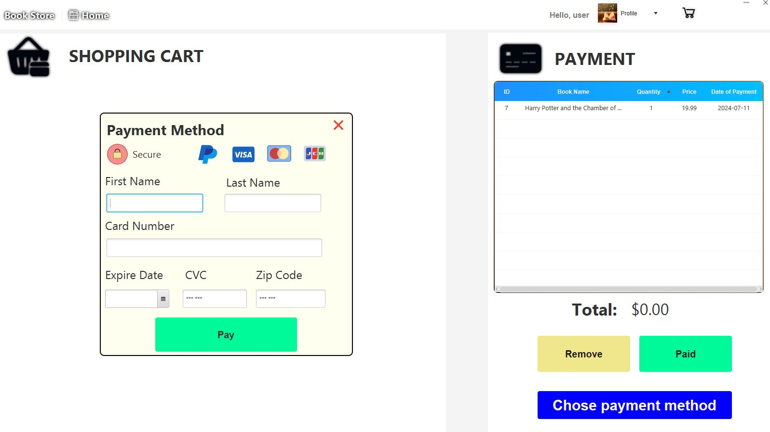
Card check

Slide 23
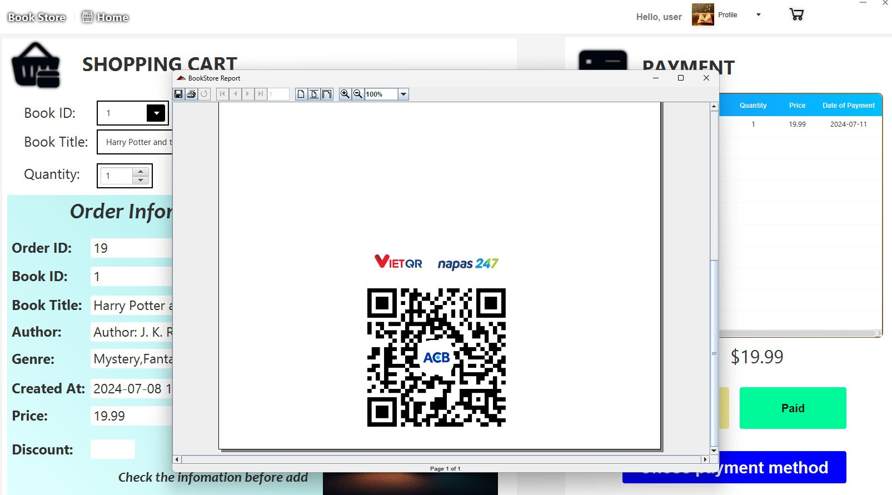
QR CODE

Slide 24
Tran Vinh Quang
Publisher-Order

Slide 25
Publisher and Order
Admin
Permission
Database:
Publisher, Order

Slide 26
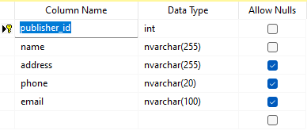
Database Publisher

Slide 27
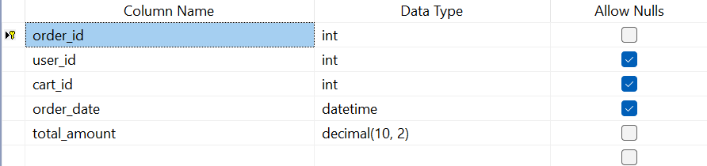
Database Order

Slide 28
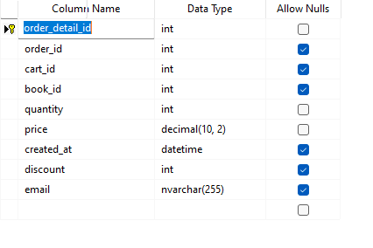
Orderdetail

Slide 29
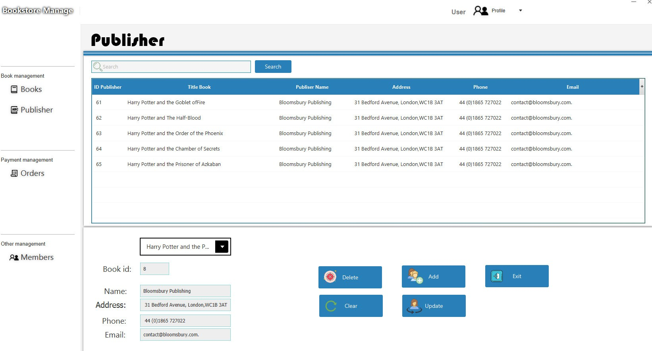
Publisher

Slide 30
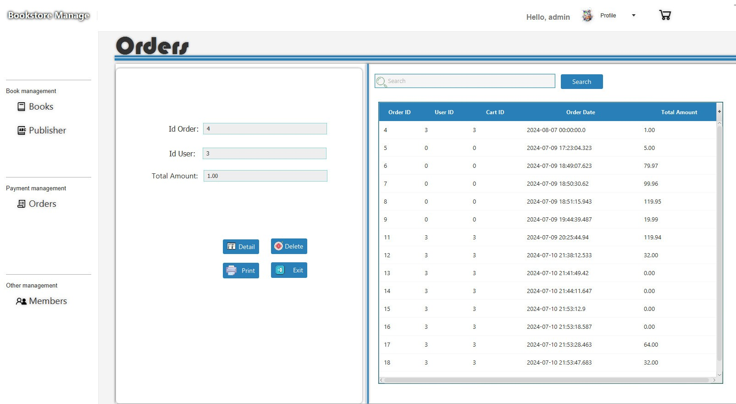
Order

Slide 31
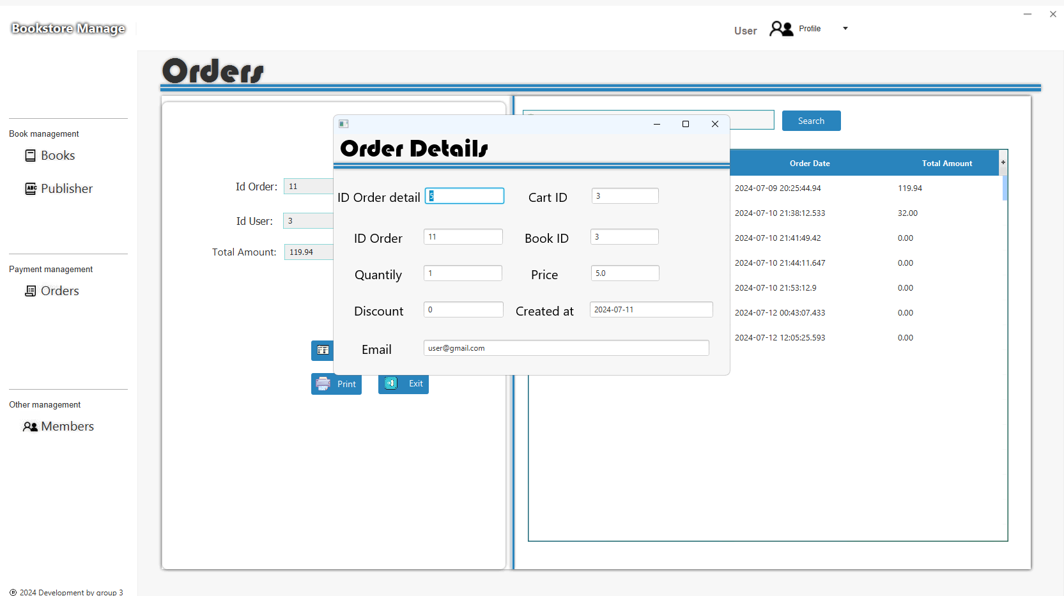
Orderdetail

Slide 32
Thank you for listening!!

